Slide 1
QUOTE
A MAN WOULD DO NOTHING, IF HE WAITED UNTIL HE COULD DO IT SO WELL THAT NO ONE WOULD FIND FAULT WITH WHAT HE HAS DONE
---Cardinal Newman

Slide 2
ATOMIC STRUCTURE
In this topic we shall talk about:
The atom and its constituents
The quantum Nos of the electron in an atom
Electronic Configuration of the elements

Slide 3
ATOMIC STRUCTURE
Define:
Atom is the basic unit of an element that can enter into (take part in a)chemical combination.
The Atom is made up of the Nucleus which is a dense central core within the Atom.
The Nucleus is +vely charged
Sub-atomic Particles
Proton: +vely charged and located at the centre of the nucleus.
Neutron: Electrically Neutral and also located at the nucleus.

Slide 4
Electron -vely charged
The atom contains the same number of p as e; electrically neutral.
Particle | Mass (g) | Charge Unit
Electron | 9.10938 x 10⁻²⁸ | – 1
Proton | 1.67262 x 10⁻²⁴ | +1
Neutron | 1.67262 x 10⁻²⁴ | 0
1 amu = 1.66 × 10^{–24} g.
Note: Mass of the Proton is about 1840 times Mass of the electron

Slide 5
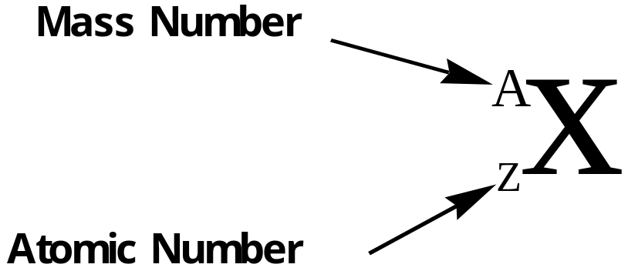
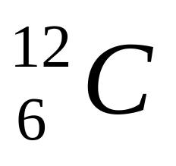
Atomic Number Z ➔ No of p or e
Atomic mass M ➔ p + n
e.g.
Mass Number = number of protons + number of Neutrons = Atomic number + Number of Neutrons
The chemical properties of an element is determined by the electrons (electronic Conf.). i.e. by the electrons and NEVER by the Neutrons

Slide 6
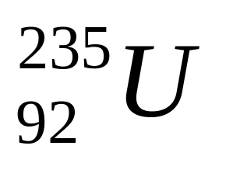
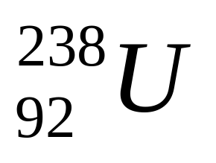
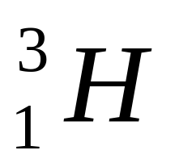
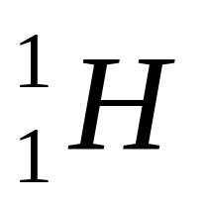
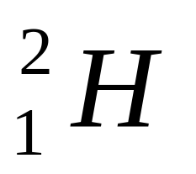
ISOTOPES: Atoms that have the same Atomic number but different mass Numbers
Uranium two thirty-five
Uranium two thirty-eight
Hydrogen
Deuterium
Tritium

Slide 7


Quantum Numbers
4 Quantum Numbers
Principal Quantum No n:
Takes values: n = 1, 2, 3, 4 etc.
  n ➔ Specifies the energy of the electron
Is the Rydberg constant and has the value 2-18 x 10⁻¹⁸ J.

Slide 8
The negative sign in the eq is an arbitrary convention, signifying that the energy of the electron in the atom is lower than the energy of a free electron, which is an election that is infinitely far from the nucleus. The energy of the free electron is arbitrarily assigned a value of zero. Mathematically, this corresponds to setting n equal to infinity in the eq. so that E∞= 0.
As the electron gets closer to the nucleus (as n decreases), E becomes larger in absolute value, but also more negative.

Slide 9
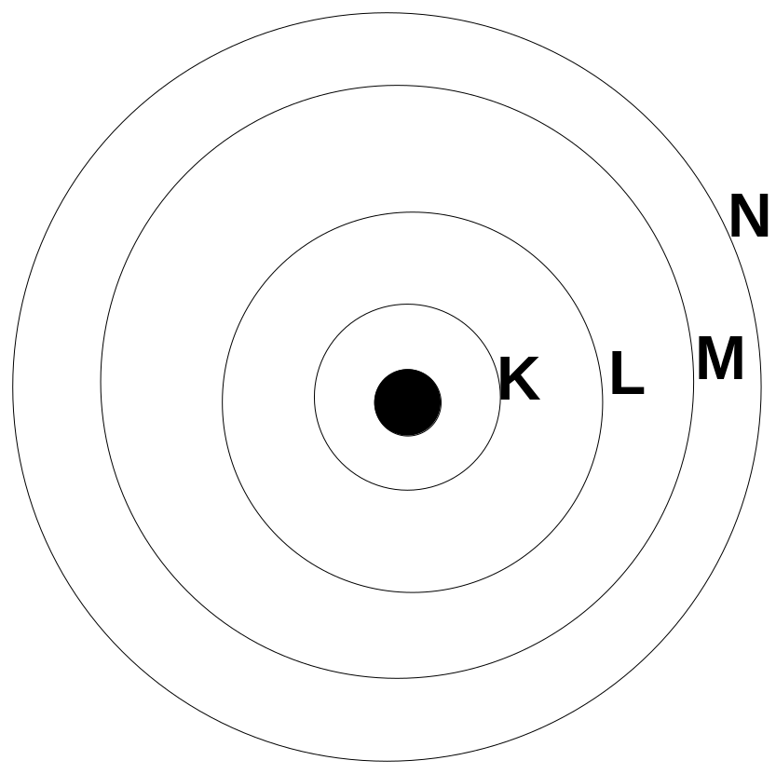
Shell | K | L | M | N | O
n | 1 | 2 | 3 | 4 | 5

Slide 10
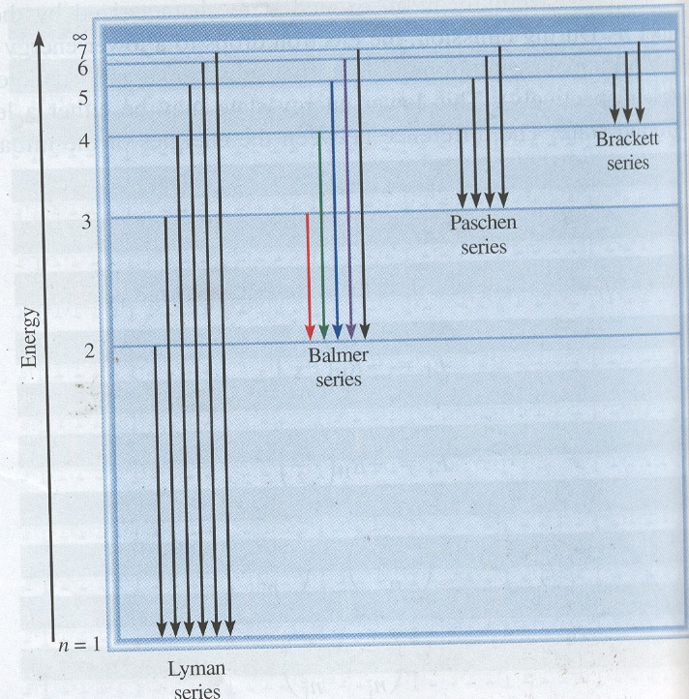

Slide 11




Suppose an electron is in an initial excited state n_{i} and during emission drops to a lower energy state n_{f}
The difference in energy between the two states is given by:

Slide 12

Worked Example
Calculate the change in Energy in the transition of an electron from n_{i} = 5 to the n_{f} = 2 state in the hydrogen atom.
SOLUTION:
The energy change ΔE = E_{f} – E_{i}
= – 4.58 x 10⁻¹⁹ J

Slide 13
Angular Momentum Quantum number, l
Angular Quantum number, l determines the shape of the orbital
Takes values from 0 to (n - 1)
Example:
When n = 1, then l = 0
n = 2, then l = 0, 1
n = 3, then l = 0, 1, 2

Slide 14
l | 0 | 1 | 2 | 3 | 4 | 5
Name of Orbital | s | p | d | f | g | h
Where:
s stands for Sharp
p stands for Principal
d stands for Diffuse
f stands for Fundamental
These are spectroscopic terms. There are only 4 spectroscopic terms. After these the next orbital follow the alphabetic listing. The next orbital after f is the g orbital followed by h orbital as so forth.

Slide 15
Magnetic Quantum Number, m_{l}
  m_{l} ➔ Describes the orientation of the orbital in space.
  Within a shell, the value of m depends on the value of the Angular momentum Quantum No l
For a given value of l, there are (2l +1) integral values of m_{l}
  Value : -l, (-l +1), …0, (+l – 1), +l
  e.g. for l = 2
  we have l = -2, -1, 0, +1, +2

Slide 16


n | l | m_{l} | No of -Orbitals | Atomic Orbital Designations
1 | 0 | 0 | 1 | 1s
2 | 0 1 | 0 -1, 0, +1 | 1 3 | 2s 2p_{x}, 2p_{y}, 2p_{z}
3 | 0 1 2 | 0 -1, 0, +1 -2, -1, 0, +1, +2 | 1 3 5 | 3s 3p_{x}, 3p_{y}, 3p_{z} 3d_{xy}, 3d_{yz}, 3d_{xz},

Slide 17
Spin quantum No
m_{s} ➔Specifies the orientation of the electron’s spin angular momentum
    Spin Quantum Number, m_{s}
        Value: ±½

Slide 18
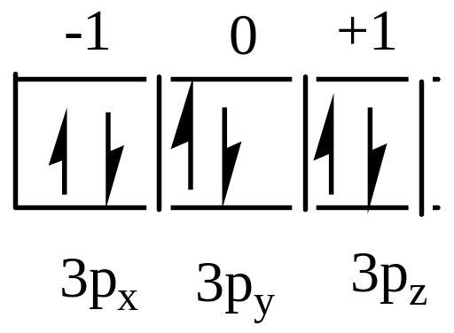
Write the Four quantum Numbers for six electrons in a 3p orbital.
electron | n | l | m | s
1 | 3 | 1 | -1 | +½
2 | 3 | 1 | 0 | +½
3 | 3 | 1 | +1 | +½
4 | 3 | 1 | -1 | -½
5 | 3 | 1 | 0 | -½
6 | 3 | 1 | +1 | -½

Slide 19
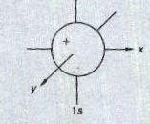
SHAPE OF THE ORBITALS
S-orbital:
Spherical in shape, centered at the nucleus. Overlap equally well in all directions

Slide 20
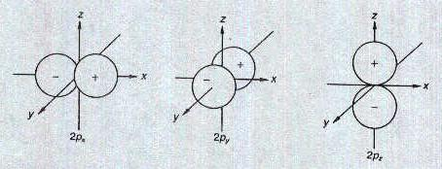
p-orbital:
Dumb-belled shaped with two lopes
directed along each of 3-axes

Slide 21
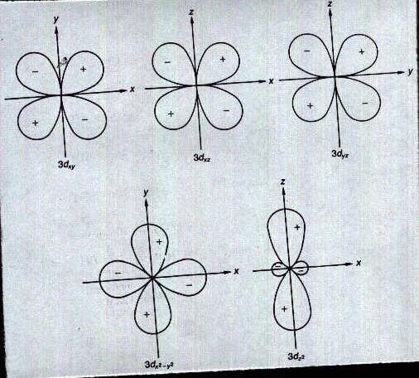
d-orbital
Double dumb-bell shaped. (5 d-orbitals)

Slide 22
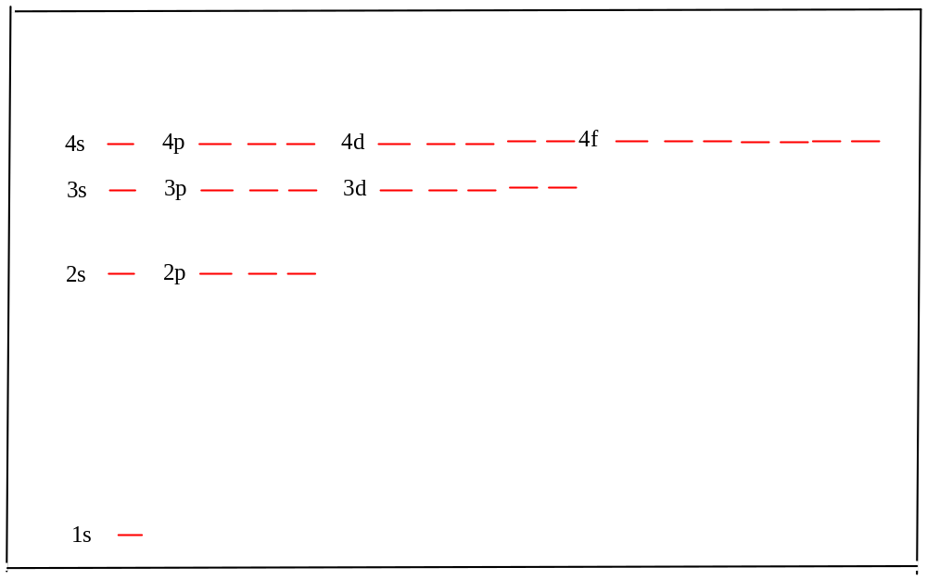
Orbital energy levels in the hydrogen atom

Slide 23
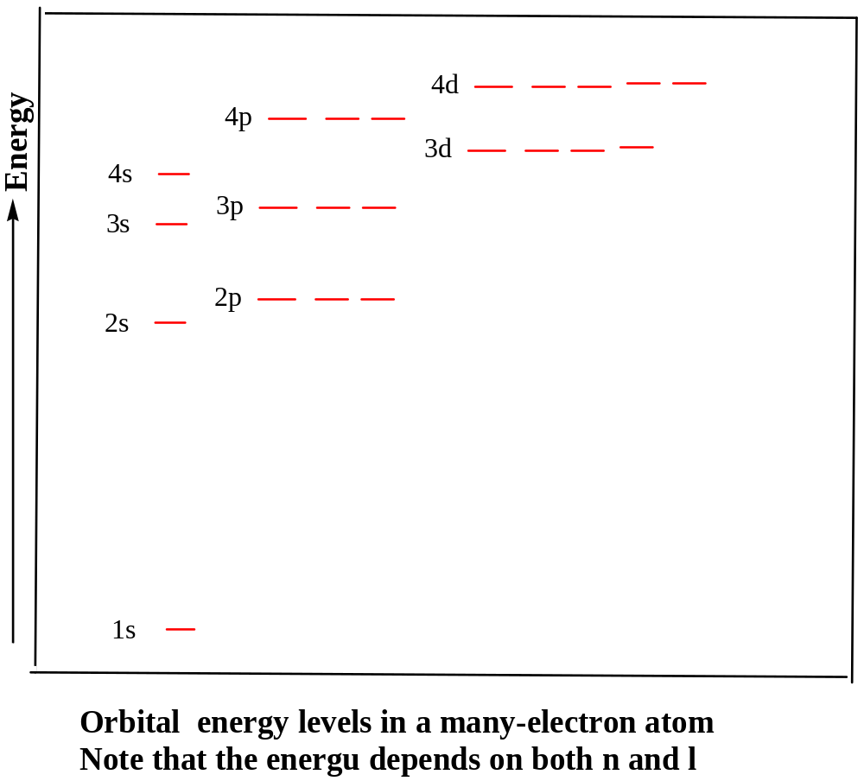

Slide 24
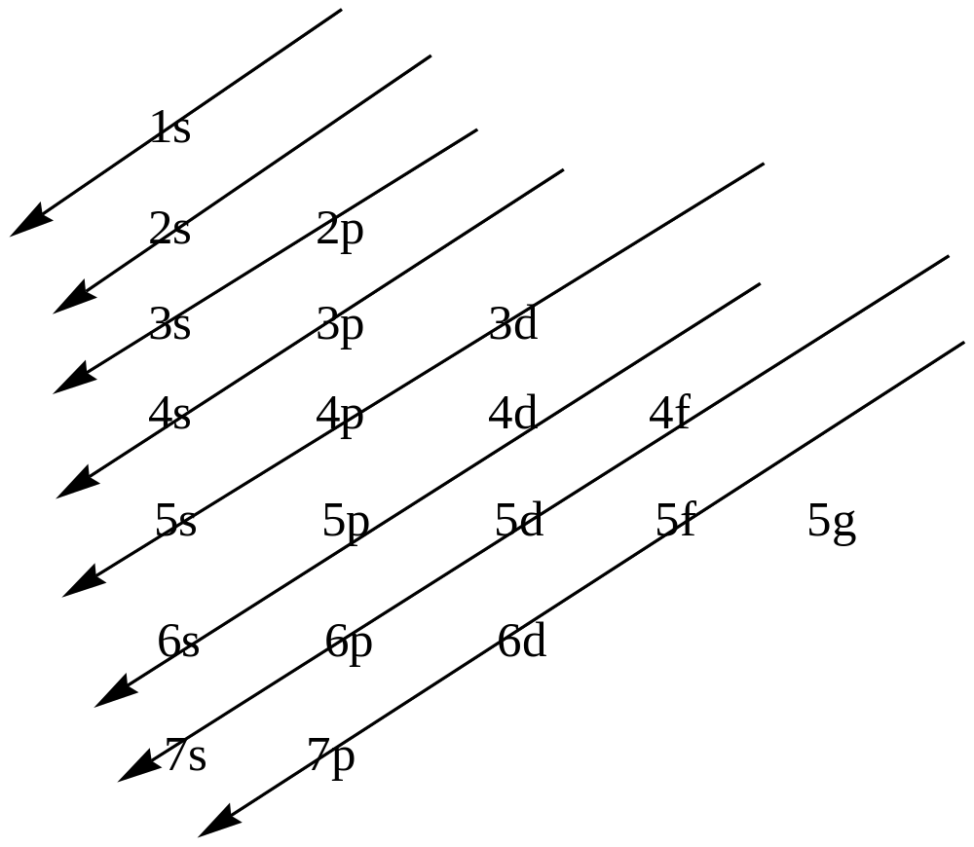
Energies of the orbitals
1s<2s<2p< 3s< 3p<4s<3d<4p<5s<4d<5p<6s <4f<5d<6p<7s

Slide 25
n + l Rule
The order above follows what is known as the
(n + l) rule.
The orbital with lowest value of n + l has the lowest energy.
When two orbitals have the same value of n + l value, the one with the lower n value takes precedence in determining the lowest energy state.

Slide 26
Examples: Which has the lowest energy: (a) (i) 4s or 4p; (ii) 5s and 4p.
SOLUTION:
(i) 4s = 4 + 0 = 4, 4p = 4 + 1 = 5. Therefore 4s has a lower energy.
(ii) 5s = 5 + 0 = 5, 4p = 4 + 1 = 5. Since n value for 4p is lower, the 4p orbital has a lower energy.

Slide 27
FILLING OF THE ORBITALS
Aufau Principle (The filling Process)
Electrons occupy orbital with lowest energy before filling those with higher energy.
e.g. Fill 1s before the 2s. Similarly Fill the 2s before filling the 2p

Slide 28
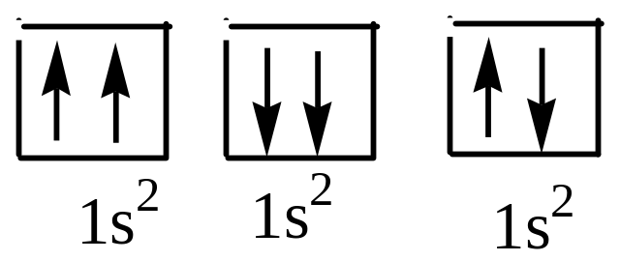
Pauli Exclusion Principle:
  No two electrons in an atom can have the same set of four quantum numbers.

Slide 29
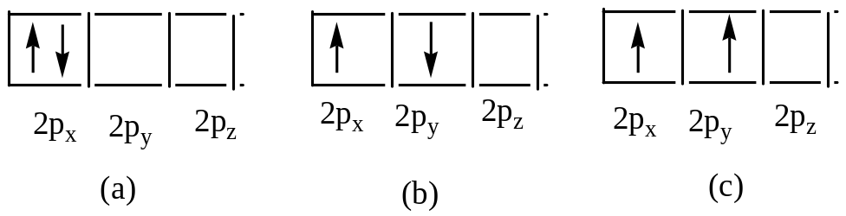
Hund’s Rule of maximum multiplicity.
  The most stable arrangement of electrons in a subshell is the one with the greatest number of parallel spins (unpaired electrons).
  Consider the electronic configuration of carbon 1s²2s²2p²
In (a) & (b) the spins cancel out. Hence the configuration for C is (c)

Slide 30
Electronic Configuration of the Elements
1 H 1s¹
2 He 1s²
3 Li 1s²2s¹
4 Be 1s² 2s²
5 B 1s² 2s² 2p¹
6 C 1s² 2s² 2p²
7 N 1s² 2s² 2p³
8 O 1s² 2s² 2p⁴
9 F 1s² 2s² 2p⁵
10 Ne 1s² 2s² 2p⁶
11 Na 1s² 2s² 2p⁶ 3s¹
12 Mg 1s² 2s² 2p⁶ 3s²
13 Al 1s² 2s² 2p⁶ 3s² 3p¹
14 Si 1s² 2s² 2p⁶ 3s²3p²
15 P 1s² 2s² 2p⁶ 3s²3p³
16 S 1s² 2s² 2p⁶ 3s²3p⁴
17 Cl 1s² 2s² 2p⁶ 3s²3p⁵
18 Ar 1s² 2s² 2p⁶ 3s²3p⁶

Slide 31
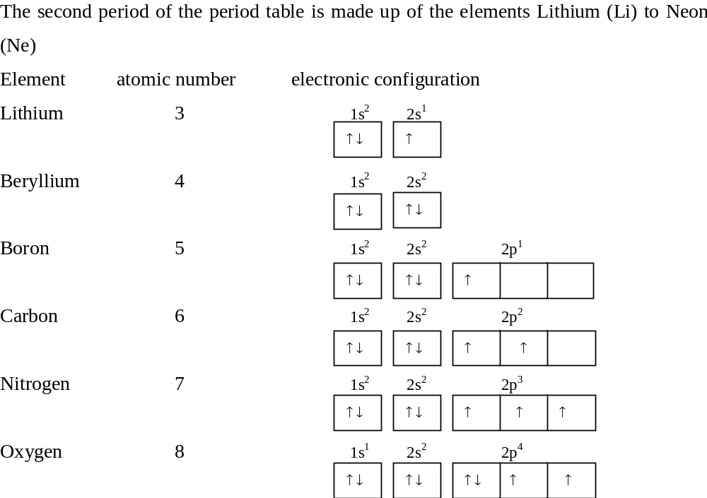

Slide 32
Work out the number of electrons that can simultaneous have (i) n= 3, l=2 (ii) n = 3
When
  n = 3
  l = 2
m = -2, -1 0 +1 +2
s = ±½ ±½ ±½ ±½ ±½
2 e 2e 2e 2e 2e
Total 10e

Slide 33
When
  n = 3
  l = 0 1 2
m = 0 -1, 0, +1 -2, -1 0 +1 +2
s = ±½ ±½ ±½ ±½ ±½ ±½ ±½ ±½ ±½
2 e 2e 2e 2e 2e 2e 2e 2e 2e
Total 18e

Slide 34
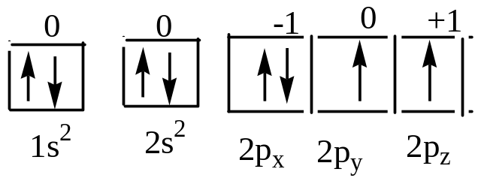
Write down the four quantum numbers for each of 8 electrons in an Oxygen atom.
Write the electron configuration of the Oxygen atom.
1s² 2s² 2p⁴

Slide 35
Electron | n | l | m | s
1 | 1 | 0 | 0 | +½
2 | 1 | 0 | 0 | -½
3 | 2 | 0 | 0 | +½
4 | 2 | 0 | 0 | -½
5 | 2 | 1 | -1 | +½
6 | 2 | 1 | 0 | +½
7 | 2 | 1 | +1 | +½
8 | 2 | 1 | -1 | -½

Slide 36
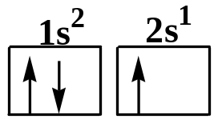
Diamagnetism and Paramagnetism
PARAMAGNETISM: Ability to attract a magnet and characteristic of substances that contain net UNPAIRED electrons.
e.g. ₃Li 1s² 2s¹
Li is therefore a paramagnetic compound
DIAMAGNETISM: Substances do not contain net unpaired electrons and REPELLED by magnet.
e.g. ₂₀Ca [Ar]4s²
Ca is therefore diamagnetic

Slide 37
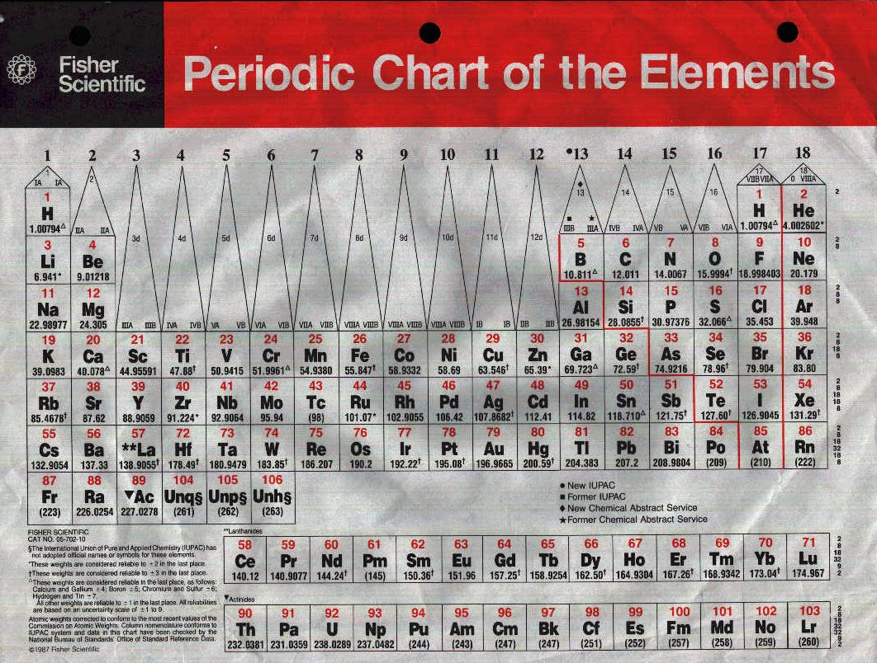

Slide 38
ELECTRONIC CONFIGURATION
Note:
1. The s-block elements
2. The p- block elements
3. The d-block elements.

Slide 39
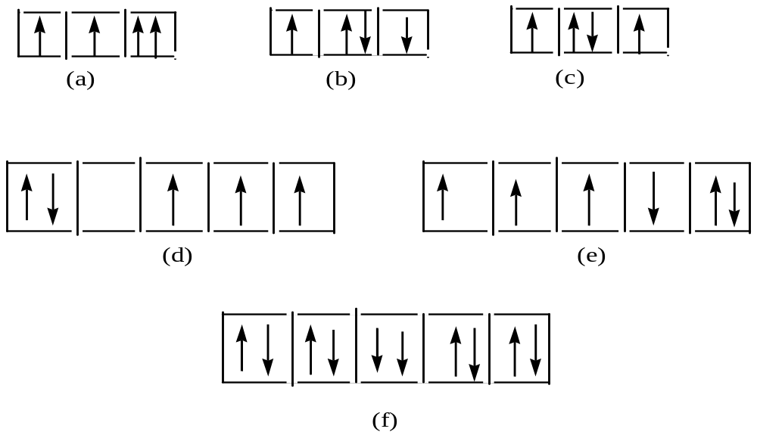
Tutorial (A)
Examine the orbital diagrams which represents the ground-state electronic configuration of certain elements. Which of them violate the Pauli Exclusion principle? Hund’s rule?

Slide 40
TUTORIAL (B):
What is the maximum number of electrons in an atom that can have the follow quantum numbers:
(a) n = 2, m_{s} = -½ (b) n = 5, l = 3; (c) n = 4, l = 3, m_{l} = -3;
TUTORIAL (C):
An ion has the electronic configuration:
1s² 2s² 2p⁶ 3s² 3p⁶ 3d²
Write the electronic configuration for the neutral atom
How many unpaired electrons are in the neutral atom.

Slide 41
ANSWER:
and (f) violate Pauli’s Exclusion Principle
: (b), (d) and (e) violate Hund’s rule

Slide 42
Read it and weep
A boy applied for a job as a public bathroom attendant. He was told he would be given the job after he filled out the form, but the boy replied that he could not write. Then interviewer informed him that he did not qualify.
On his way home, the boy saw some apples that were underpriced and bought them. He sold them for double the price.
As the years passed, he ended up becoming a millionaire who owned a chain of 20 fruit stores.

Slide 43
One day his bank manager asked him to sign some papers.
“Sorry” he said “I can’t write. My wife looks after that.”
You are kidding! said the bank manager. “What would you have become if you could write?”
The millionaire thought for a moment and said: “a public bathroom attendant.”

Slide 44
END
THIS IS THE END OF THIS SESSION.
I HOPE WE ARE ALL FOLLOWING.
PLEASE FEEL FREE TO ASK ANY QUESTIONS.

